Slide 1
Azure DevOps
Marwan maged:211000328

Slide 2

What is Azure DevOps
is a comprehensive set of cloud-based tools and services offered by Microsoft to streamline and optimize the entire software development lifecycle.

Slide 3
Importance in software development
End to end solution for IT and business teams for planning and automation.
Cloud solution , no need for any server on my datacenter .

Slide 4
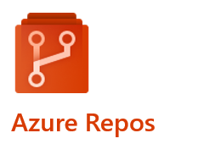
Azure Repos is a version control system offered by Microsoft Azure, designed to empower teams in efficiently managing and collaborating on software development projects. This platform provides a secure and scalable environment for hosting and tracking source code.

Slide 5
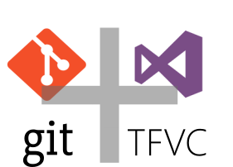
Repository Types

Slide 6
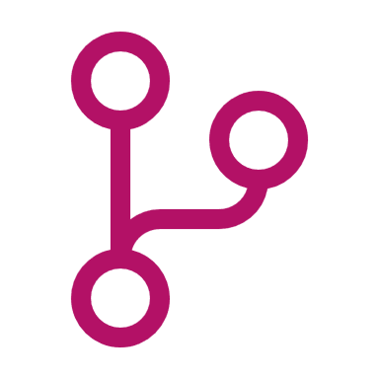
git
Git is a distributed version control system.
Each developer has a complete copy of the codebase.
Excellent for distributed and open-source projects.
Provides branching, merging, and pull requests.
Encourages collaboration and flexibility.

Slide 7

Team Foundation Version Control (TFVC)
TFVC is a centralized version control system.
Code is stored on a central server.
Well-suited for organizations with complex branching and merging needs.
Offers features like label-based versioning and changeset tracking.
More rigid structure and security controls.

Slide 8

Azure Boards
Azure Boards is a collaborative work tracking system offered by Microsoft Azure that facilitates project management and tracking of work items throughout the software development lifecycle. It is a powerful tool for teams to plan, track, and discuss work seamlessly.

Slide 9

Azure Pipelines
Azure Pipelines is a powerful Continuous Integration and Continuous Deployment (CI/CD) service provided by Microsoft Azure. It helps development teams automate and streamline the software delivery process, from building and testing to deploying applications to various target environments.

Slide 10

Azure Test Plans
It is a test management module within Azure DevOps that lets users manage test plans, test suites, and test cases for everyone in the software development process.
Track and assess quality throughout your testing lifecycle.
Capture rich data
Test across web and desktop
Get end-to-end traceability

Slide 11

Azure artifact
Mange all package types(Maven & npm and NuGet).
Add packages to any pipeline.
Share code efficiency.
Integration with Azure DevOps.

